Slide 1

Inheritance Challenge
Now it's time for a challenge, to solidify your understanding, of what inheritance is.
For this challenge, I'm going to show you a class diagram, like we worked with in the previous videos.
COMPLETE JAVA MASTERCLASS
Inheritance Challenge - Part 1

Slide 2
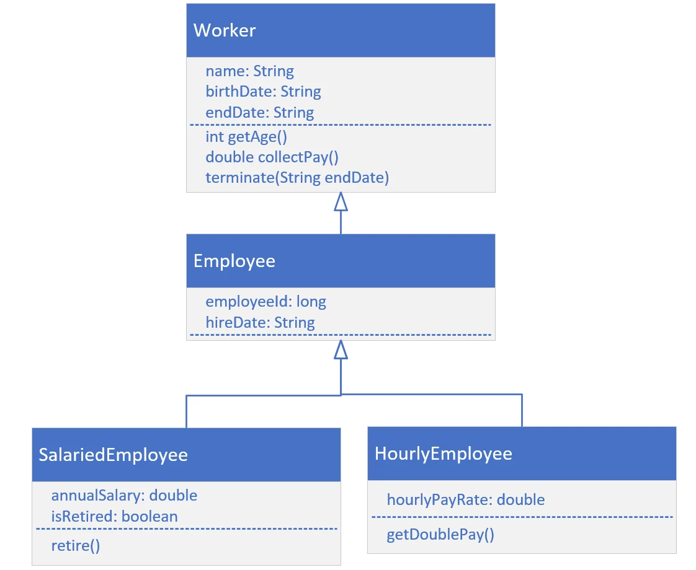
Inheritance Challenge
Your challenge is to create the Worker class, the Employee class, and either the SalariedEmployee, or the HourlyEmployee class.
For each class, create the attributes and methods shown on this diagram.
Create a main method that will create either a SalariedEmployee or HourlyEmployee, and call the methods, getAge, collectPay, and the method shown for the specific type of class you decide to implement.
COMPLETE JAVA MASTERCLASS
Inheritance Challenge - Part 1

Slide 3
Inheritance Challenge
So if you implement SalariedEmployee, then execute retire().
If you implement HourlyEmployee, then execute getDoublePay().
COMPLETE JAVA MASTERCLASS
Inheritance Challenge - Part 1

Slide 4
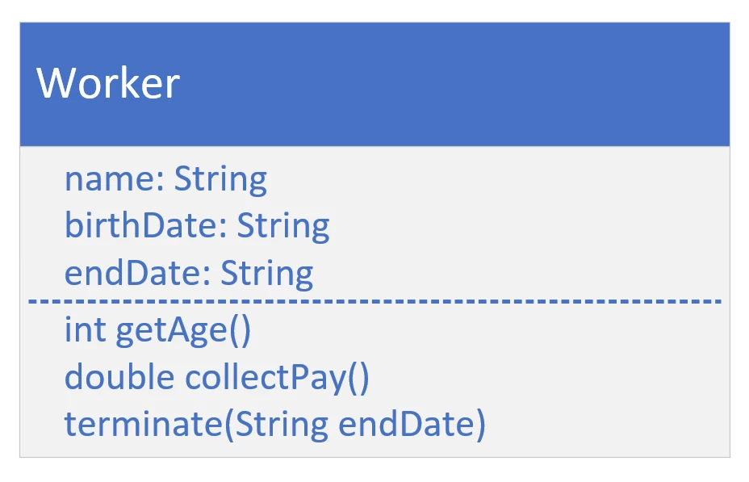
Worker class
COMPLETE JAVA MASTERCLASS
Inheritance Challenge - Part 1

Slide 5
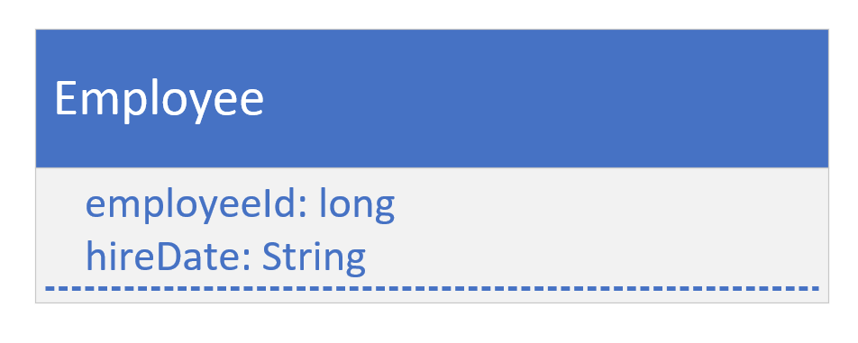
the Employee Class
For this class, we have specific Employee attributes, employeeId, and hireDate.
For simplicity's sake, we haven't included any methods specific to an Employee.
COMPLETE JAVA MASTERCLASS
Inheritance Challenge - Part 1

